Slide 1

MINISTRY OF AGRICULTURE
ABIA STATE CSS FARMS TRAINING INITIATIVE
SUPERVISION REPORT FROM THE
17 LGAs OF ABIA STATE

Slide 2
Introduction - Abia State overview
Key highlights
Map of Nigeria
South East, Nigeria
Geopolitical Zone
6,320
Total landmass (sq km)
4.8m
State population (2022)
1991
Year of Creation
17
Local Government
Areas (LGAs)
49%
% of Male
Umuahia
Capital City
2
Climatic seasons: the rainy and dry seasons; Predominantly Rain forest vegetation agro-ecology
51%
% of Female
Key
Abia State
Igbo
Major language
3
Agricultural zones, namely:
Aba (Abia South), Ohafia (Abia North) and Umuahia (Abia Central).
Abia State is bordered by South-Eastern and South-Southern States of Anambra, Ebonyi, Enugu, Imo, Cross River, Akwa Ibom and Rivers.

Slide 3

In a bid to promote economic prosperity through focused job creation and youth empowerment in agriculture, His Excellency, the Executive Governor of Abia State, Dr. Alex Chioma Otti (OFR) initiated the training of three hundred and two (302) Abia youths on various components of agriculture at CSS farms, Nasarawa State. Selection was based on a mix of criteria:
- 184 from the 184 wards – Abia Arise
- 17 from Mayors
- 2 from ADP
- 64 from Fed and State House members
- 35 Executive Discretion
Two hundred and ninety-eight (298) of these youths who presented business plans were duly empowered to implement what they were trained on through the disbursement of interest-free loans totaling N576.7m.
A five-man committee was formed by the Honorable Commissioner of Agriculture, to conduct a supervision exercise to assess the level of implementation of the programme in 184 wards of the state from March, 2025 – June, 2025.
A state-wide supervision exercise was conducted to determine the level of implementation and compliance on the part of the beneficiaries.
Abia State CSS Farms Project Initiative
3

Slide 4
Summary Statistics
Sex | Enterprise |  |  |  |  | Total
 | Livestock/Poultry | Fish Farming | Open field | Value addition | Green house
Male | 82 | 41 | 60 | 32 | 4 | 219
Female | 24 | 16 | 22 | 12 | 5 | 79
Total | 106 | 57 | 82 | 44 | 9 | 298
4

Slide 5
Summary Statistics
5

Slide 6
Beneficiaries Availability
Assessment | No. of Beneficiaries | %
Presented | 268 | 89.93%
Refused to Present | 26 | 8.72%
ill-Health | 4 | 1.34%
Total | 298 | 100.00%
6

Slide 7
Beneficiaries Compliance Rating
7

Slide 8
THE FOLLOWING BENEFICIARIES COULD NOT PRESENT THEMSELVES FOR ASSESSMENT DUE TO HEALTH CHALLENGES
S/N | Name of beneficiaries | LGA | Remarks
1 | Ejike Ebere | Ugwunagbo | Reported Sick (Diabetics Complications)
2 | Ekuru-Bob Henry Nwabueze | Umuahia South | Sick with kidney problem, has been in and out of hospital.
3 | Awomukwu Angela C. | Isialangwa North | Reported sick
4 | Njoku Nehemiah | Arochukwu | Reported sick with 2 kidney stones
Regrettably, we received a report of the demise of two beneficiaries; Mrs. Chinonye I. Egbulefu from Ikwuano LGA and Mr. Ejike Ebere from Ugwunagbo LGA
Abia State CSS Farms Project Initiative
8

Slide 9
LGA | No. of Beneficiaries | Amount Received
Aba North | 14 | 28,229,625.00
Aba South | 19 | 34,342,500.00
Arochukwu | 22 | 36,752,500.00
Bende | 16 | 29,315,000.00
Ikwuano | 18 | 30,752,500.00
Isialangwa North | 22 | 42,670,000.00
Isialangwa South | 27 | 53,000,000.00
Isuikwuato | 12 | 25,605,000.00
Obingwa | 12 | 24,662,500.00
Ohafia | 21 | 45,562,500.00
Osisioma | 19 | 39,110,000.00
Ugwunagbo | 12 | 21,150,000.00
Ukwa East | 11 | 21,790,000.00
Ukwa West | 10 | 20,062,500.00
Umuahia North | 26 | 50,960,000.00
Umuahia South | 18 | 38,292,500.00
Umunneochi | 17 | 31,070,375.00
Abia ADP | 2 | 3,372,500.00
Total | 298 | 576,700,000.00
CSS AMOUNT
ALLOCATION
BY LGA
Abia State CSS Farms Project Initiative
9

Slide 10
LGA | No. of Beneficiaries | No. of active Incubatees
Aba North | 14 | 28
Aba South | 19 | 58
Arochukwu | 22 | 41
Bende | 16 | 35
Ikwuano | 18 | 30
Isialangwa North | 22 | 50
Isialangwa South | 27 | 52
Isuikwuato | 12 | 20
Obingwa | 12 | 26
Ohafia | 21 | 46
Osisioma | 19 | 34
Ugwunagbo | 12 | 7
Ukwa East | 11 | 13
Ukwa West | 10 | 10
Umuahia North | 26 | 43
Umuahia South | 18 | 44
Umunneochi | 17 | 28
Abia ADP | 2 | 0
Total | 298 | 565
CSS AMOUNT
ALLOCATION
BY LGA
Abia State CSS Farms Project Initiative
10

Slide 11
S/N | Challenges | Observations | Recommendation(s)
1 | Some wards/farms were hard-to-reach areas, making it very difficult and more expensive to visit | Some of the beneficiaries were politically engaged and/or involved in some other businesses which led to their little or non-compliance to the programme | The government should target unemployed youths (who are interested in agricultural enterprises) and young farmers rather than politicians (Abia Arise Members) in subsequent programmes like this.
2 | Multiple visitations to some LGAs due to unavailability of some beneficiaries on the scheduled visit days | Many of the trainees that were to be trained by the trained beneficiaries were residing far from the farm location, making it impossible for them to be trained. The reason being that the trainees were politically selected by their sponsors and not by the farmer himself.
3 | Some of the beneficiaries were very rude and were not cooperative to the supervisory team | Some of the beneficiaries saw this loan as grants rather than a loan to be paid back, making them nonchalant to the investment of the loan into agricultural business/enterprise as agreed
11

Slide 12
PICTORIAL REPRESENTATION OF ABIA STATE CSS FARMS TRAINEES PROJECT SUPERVISION ACCORDING TO LGA

Slide 13
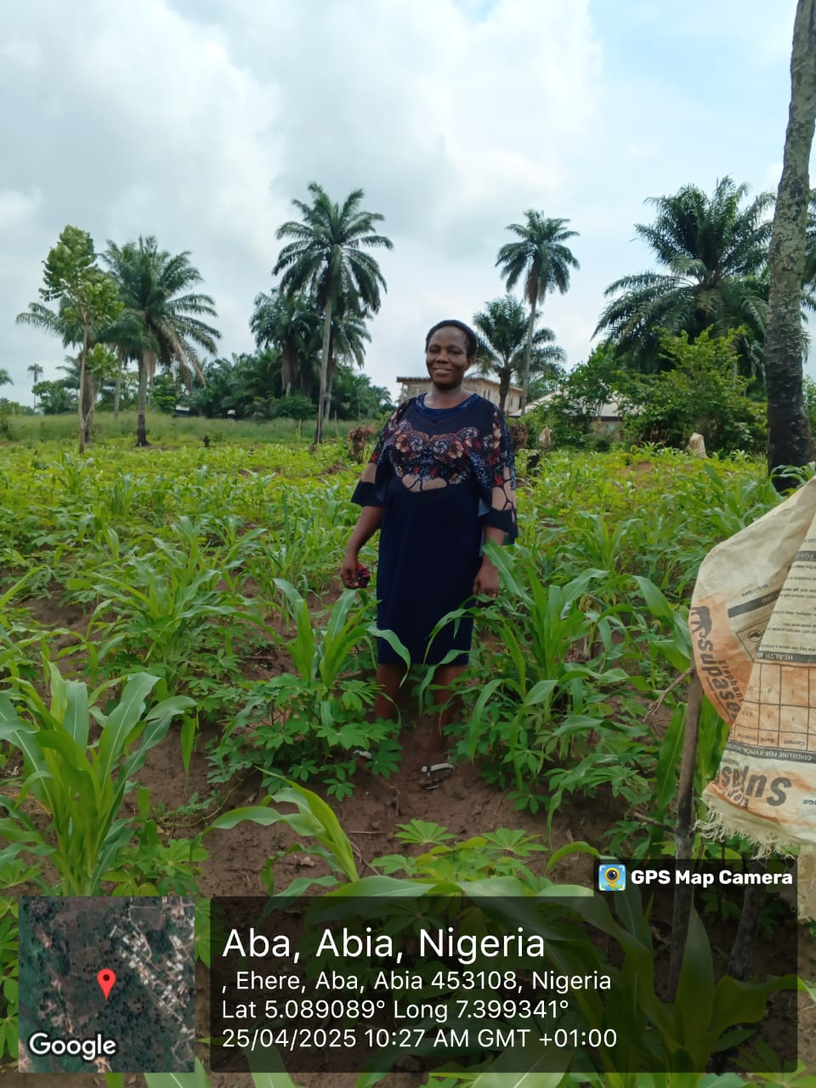
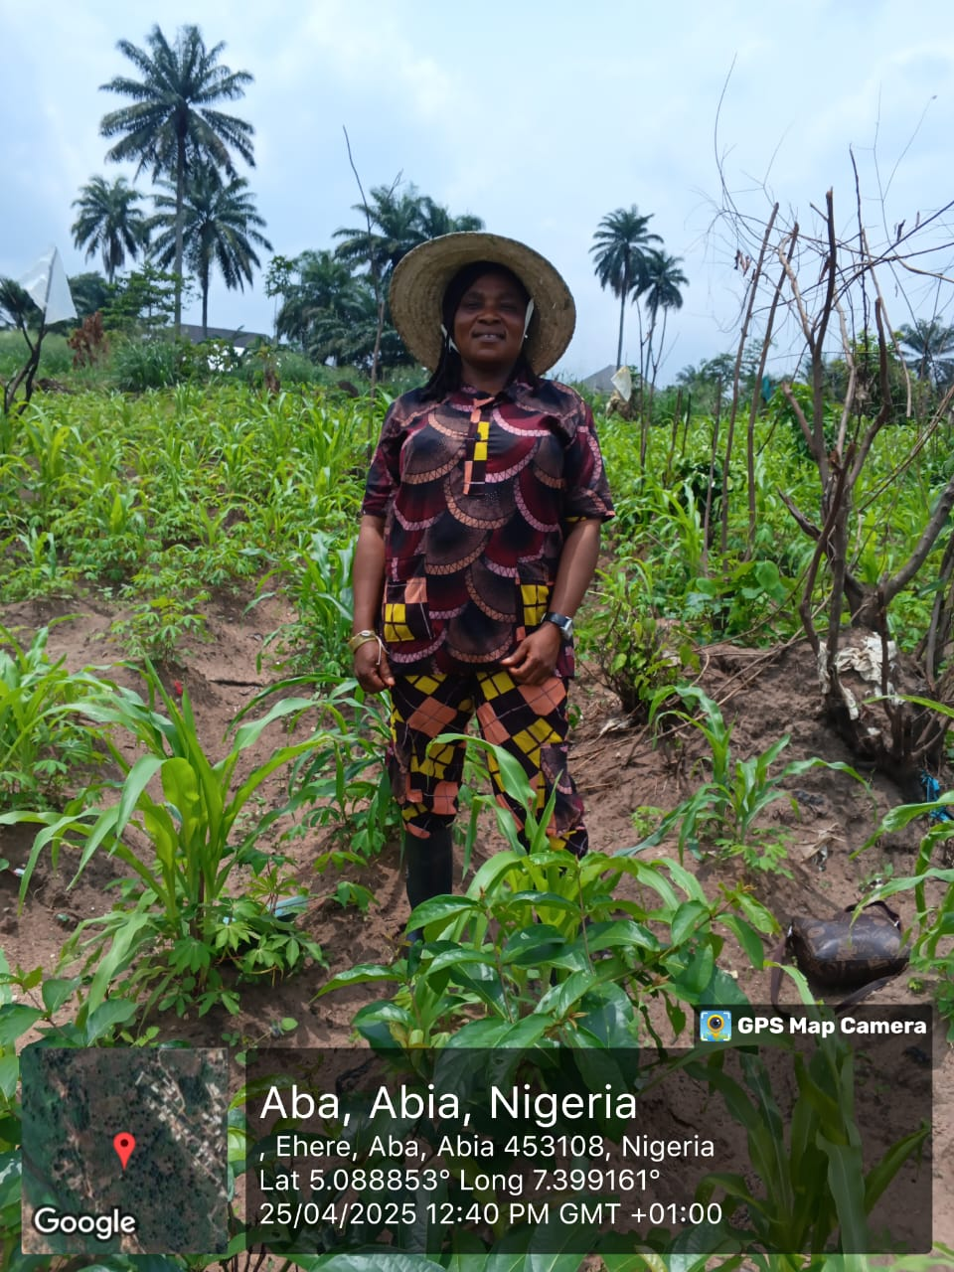
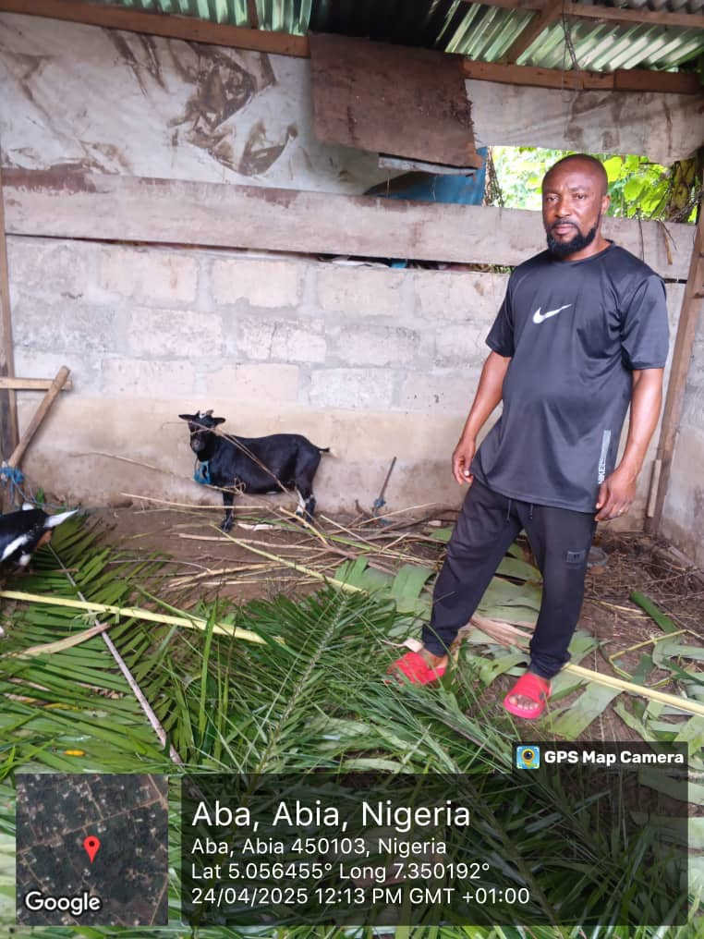
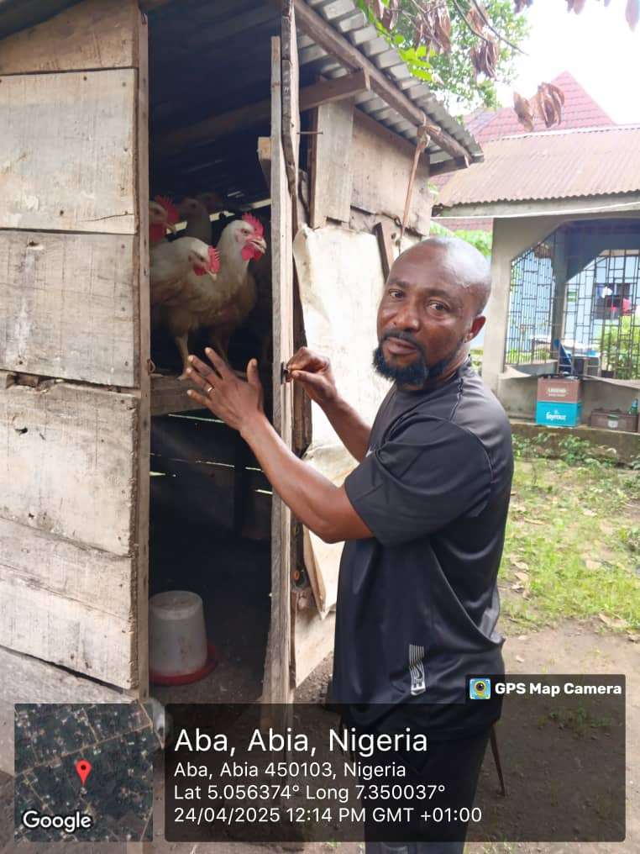
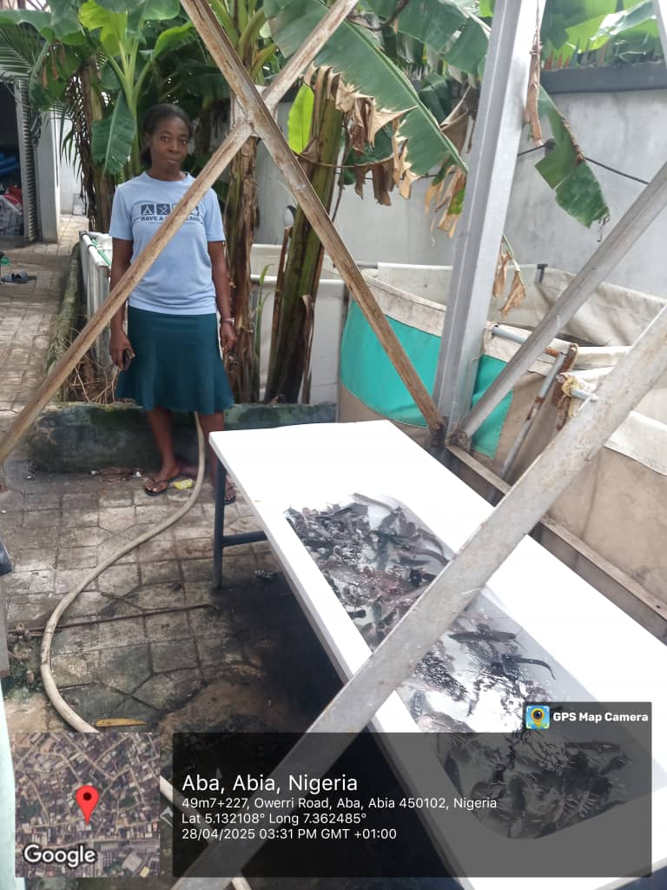
Aba North
Open field beneficiaries in their cassava/maize farm in Ehere
A beneficiary in goat and broiler enterprise
A beneficiary in fisheries enterprise with adult fish and juveniles

Slide 14
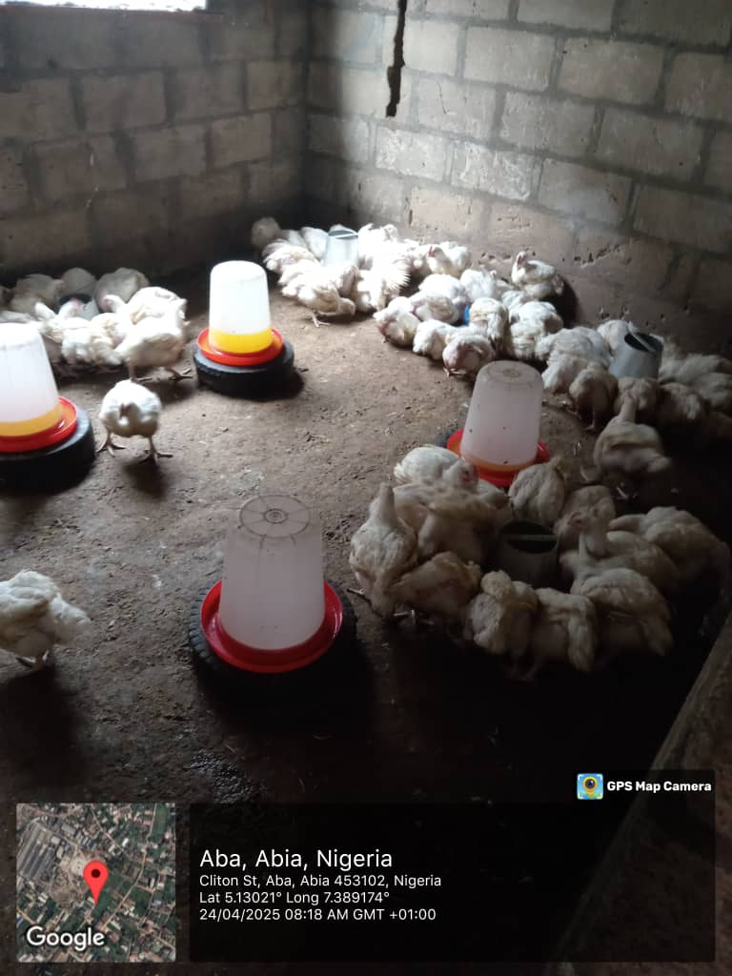
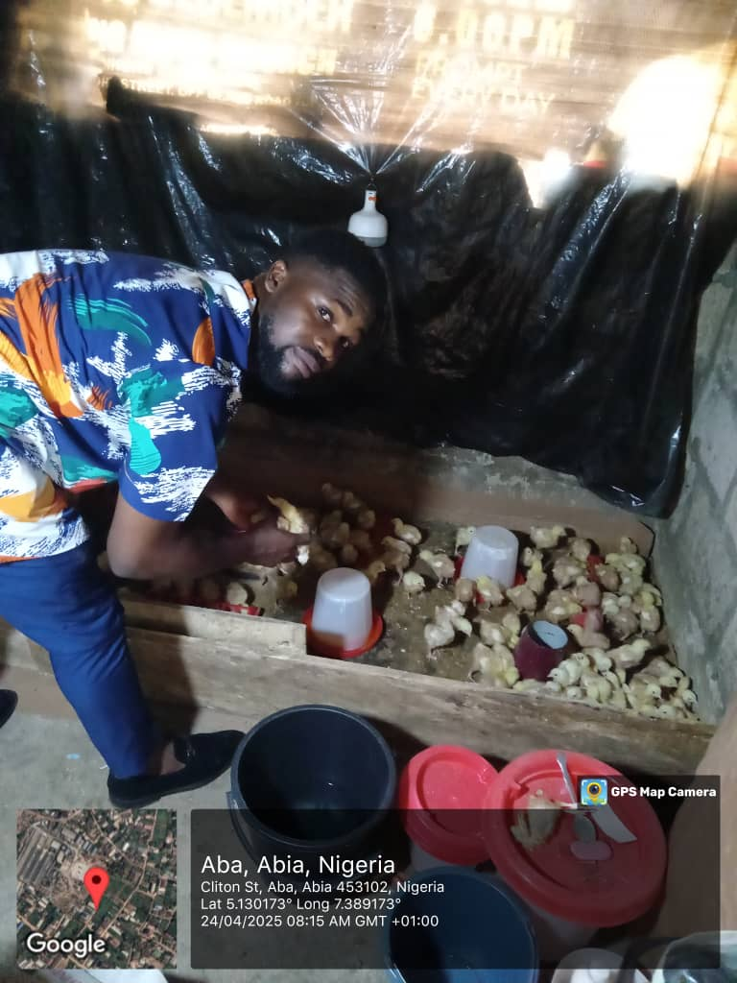
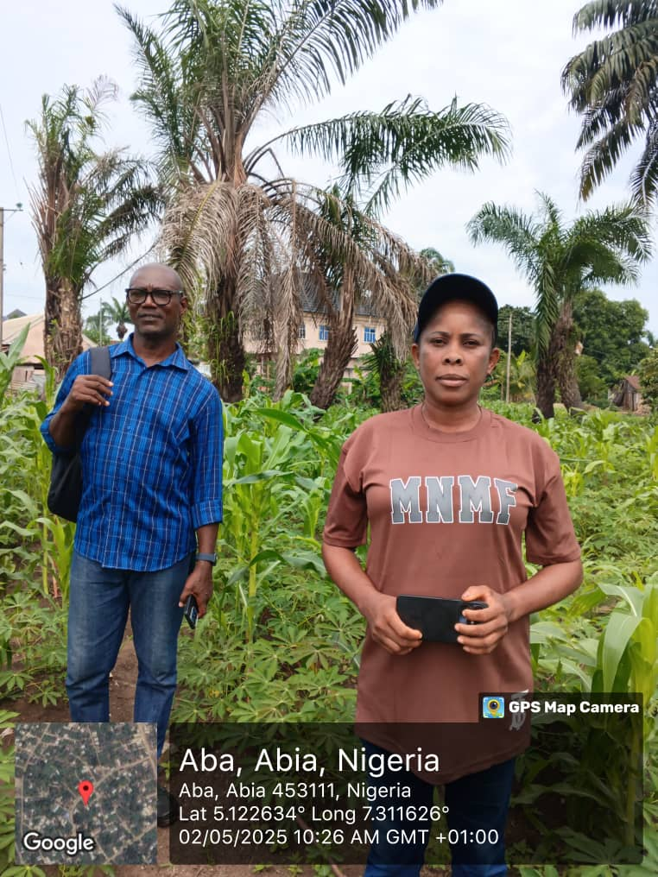
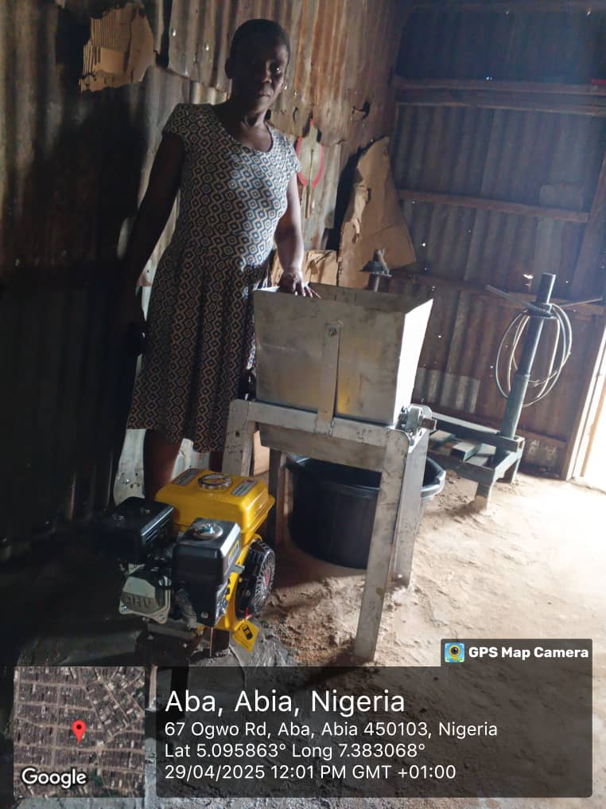
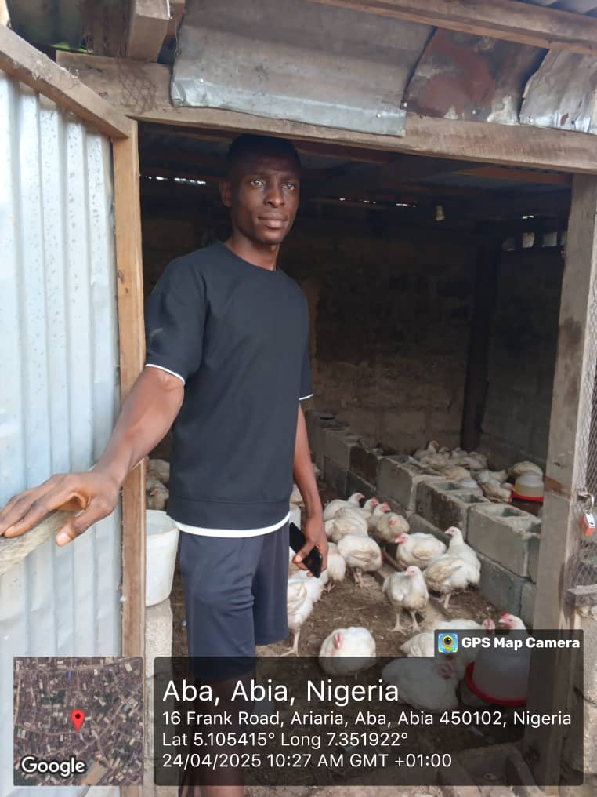
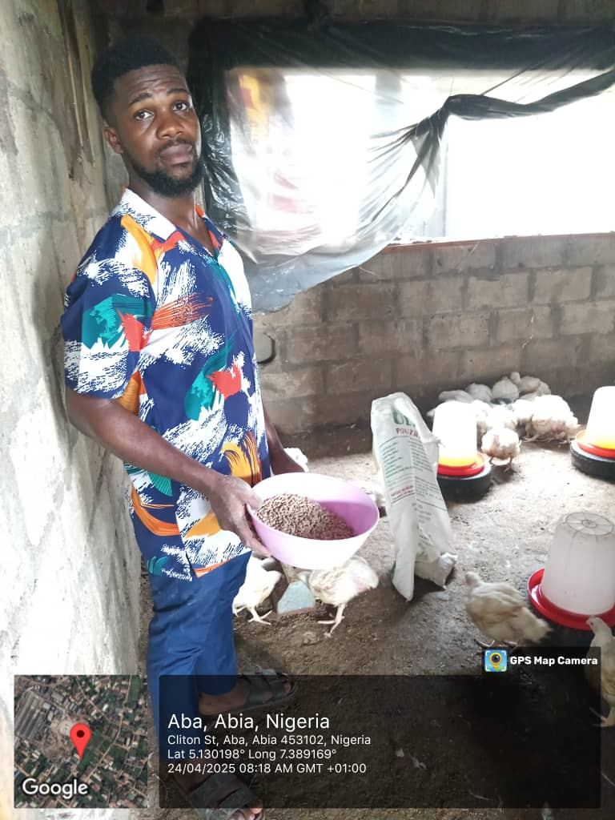
Aba South
A beneficiary with ready-for-market birds and few days old chicks (top right) in brooding pen
An open field beneficiary posing in front of her cassava/maize/egusi farm
A beneficiary in value addition (Garri processing)
A beneficiary with matured birds ready for sale

Slide 15
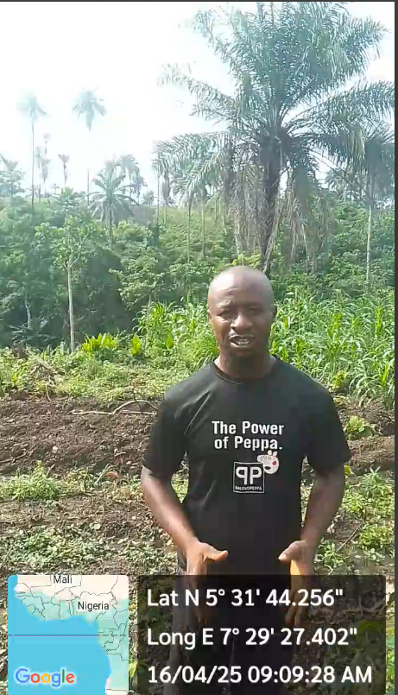
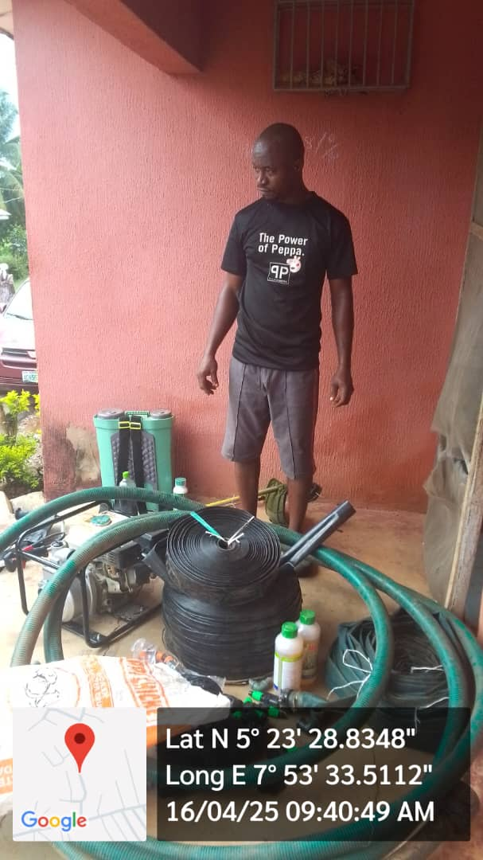
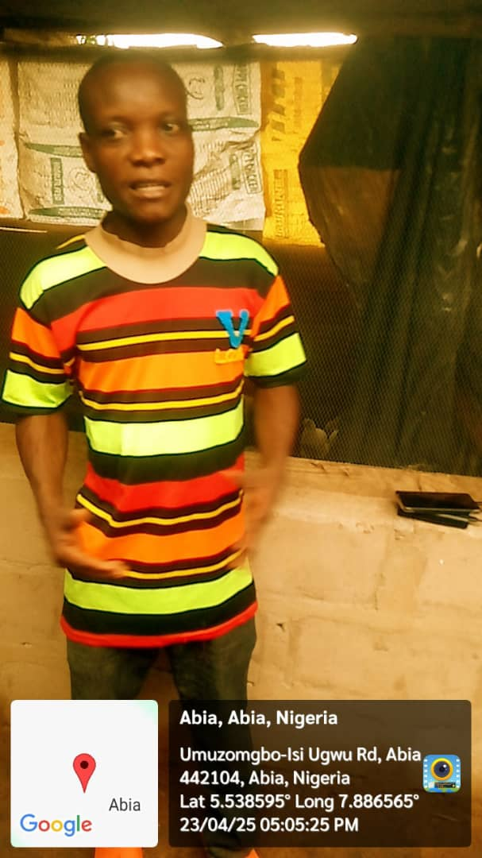
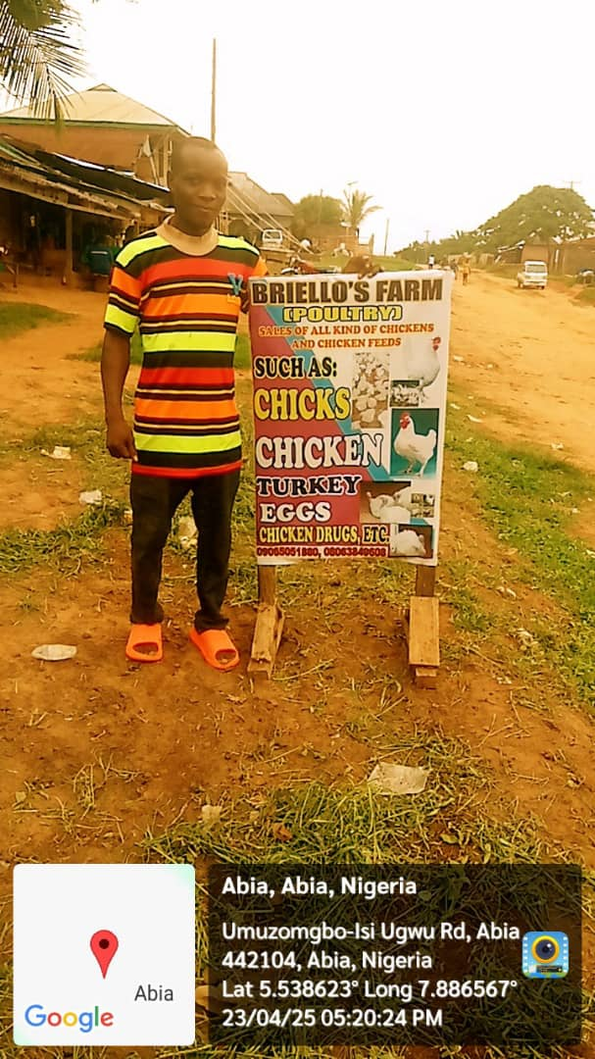
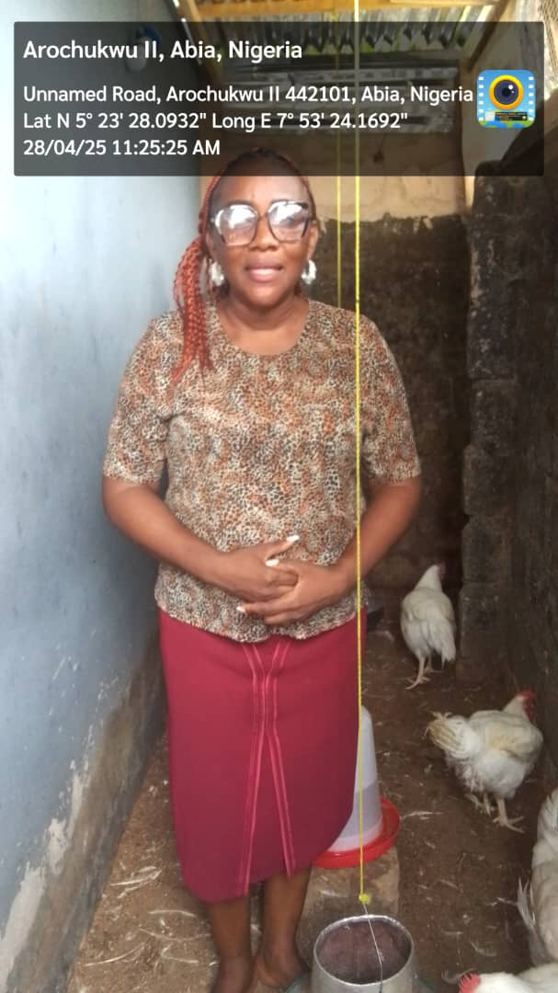
Arochukwu
A beneficiary showing his newly bought pumping machine to the team, the machine is been use to irrigate the farm
A beneficiary in poultry enterprise and also sales accessories use in poultry farming
Another beneficiary in Arochukwu rearing broilers.

Slide 16
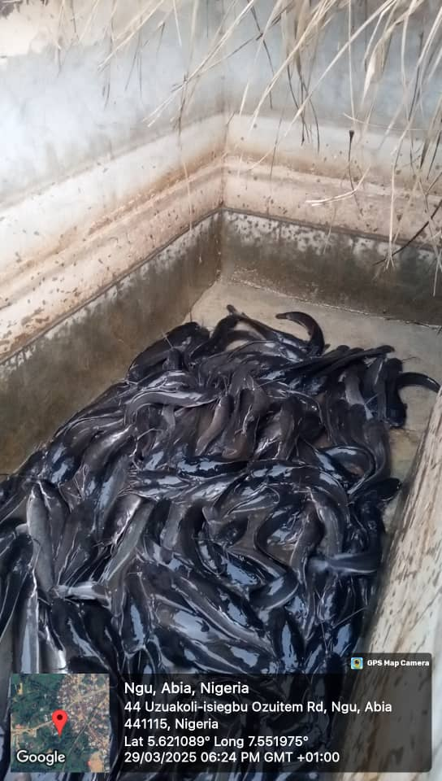
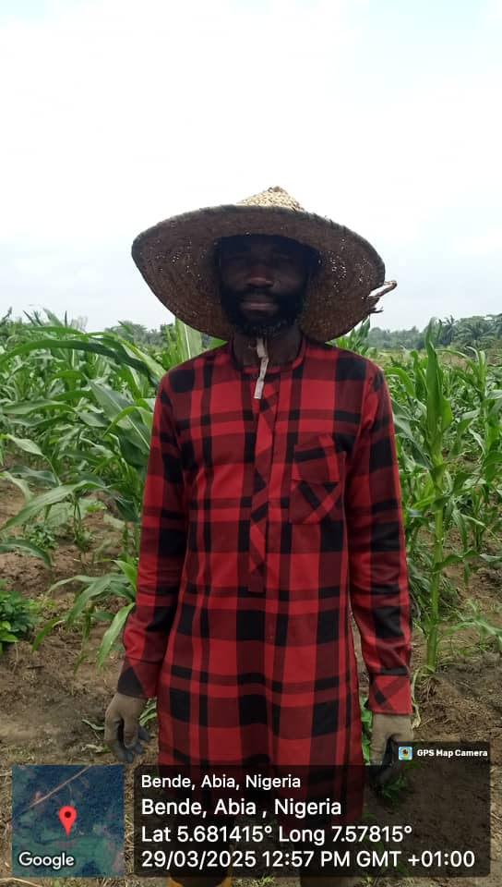
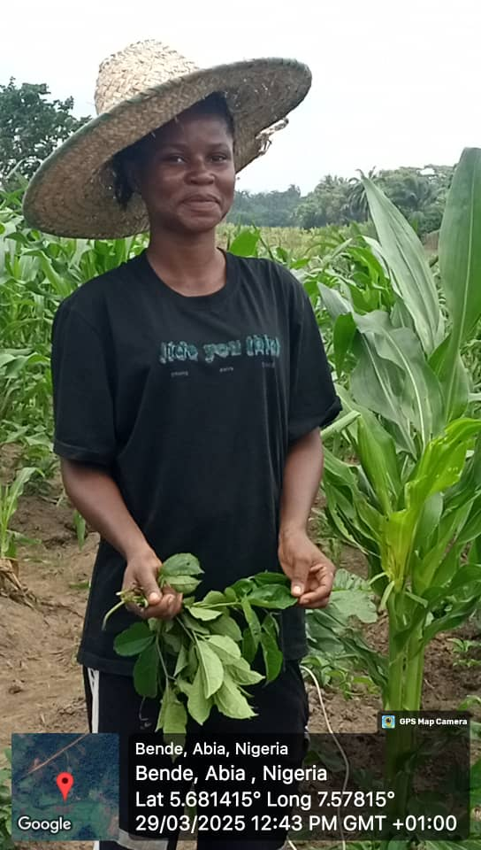
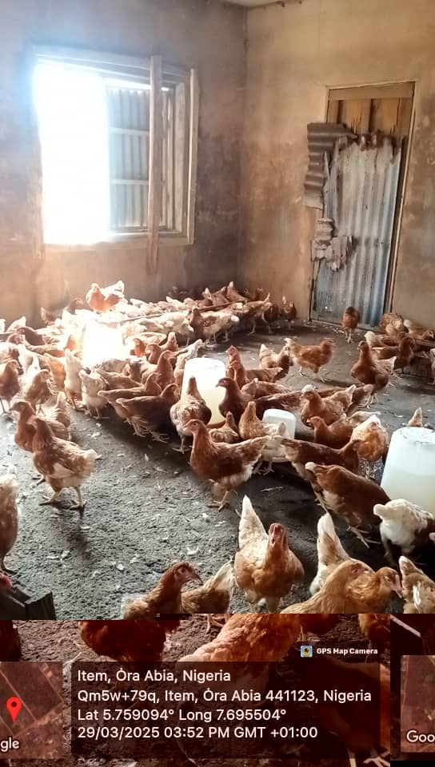
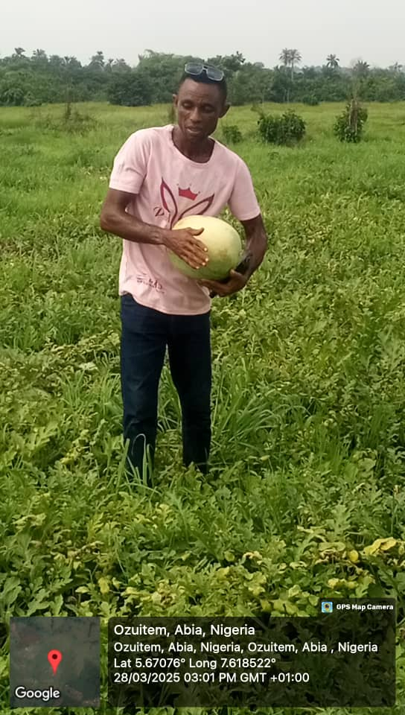
Bende
A well-built pond with healthy fish in Ngu owed by one of the beneficiaries
Open field beneficiaries in Bende, showing their rebust and health crop farms
A well ventilated, spaced layers farm in Item
A beneficiary in his water melon farm in Ozuitem

Slide 17
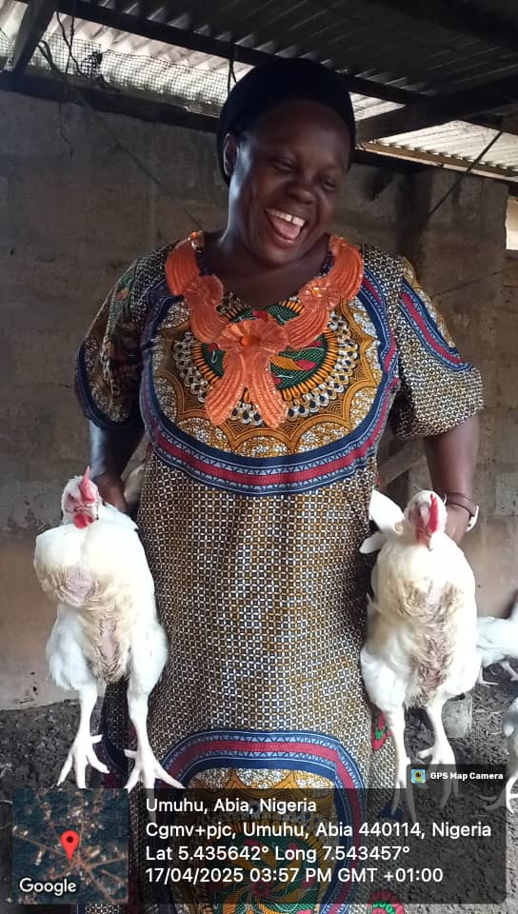
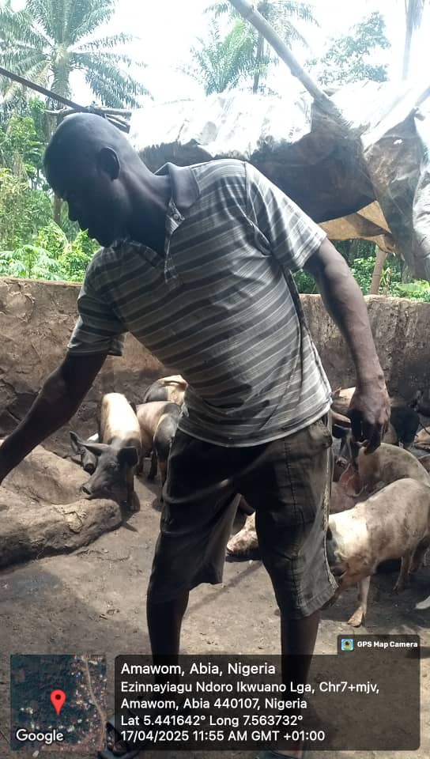
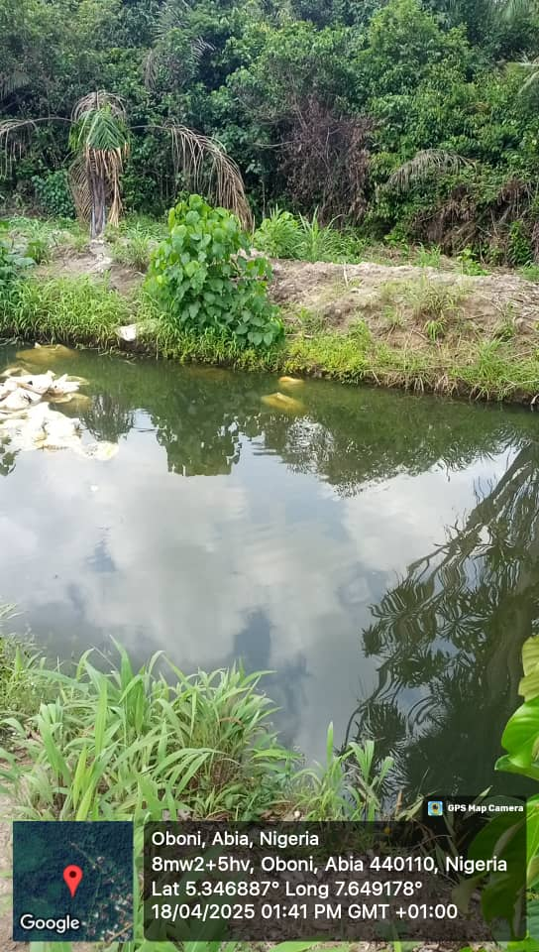
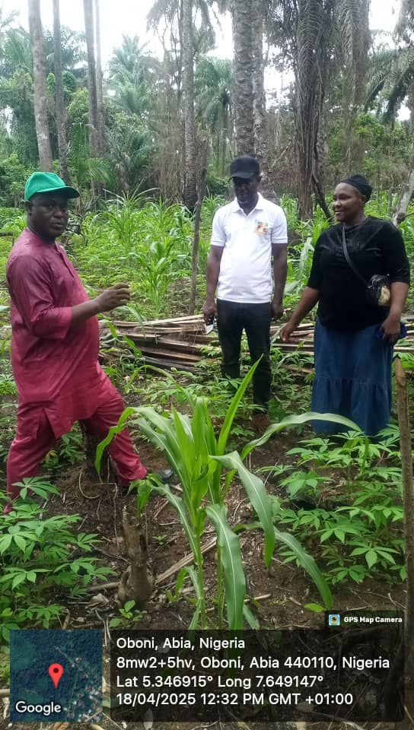
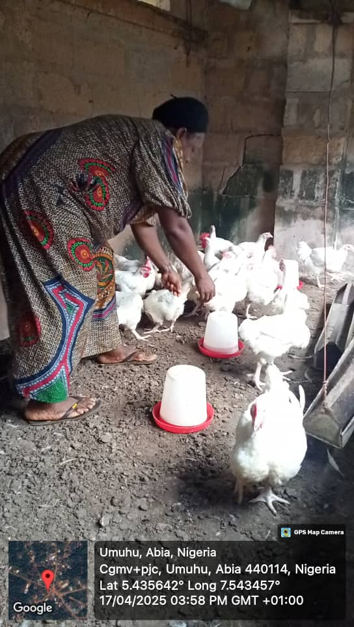
Ikwuano
From left-right: a proud and happy beneficiary showcasing her matured birds in Omuhu, a newly constructed earthen pond owned by a beneficiary in Ekpiri, a beneficiary in his piggery farm in Amawom and an open field beneficiary with the Director of CSS farms and his team in Oboni ikpa.

Slide 18
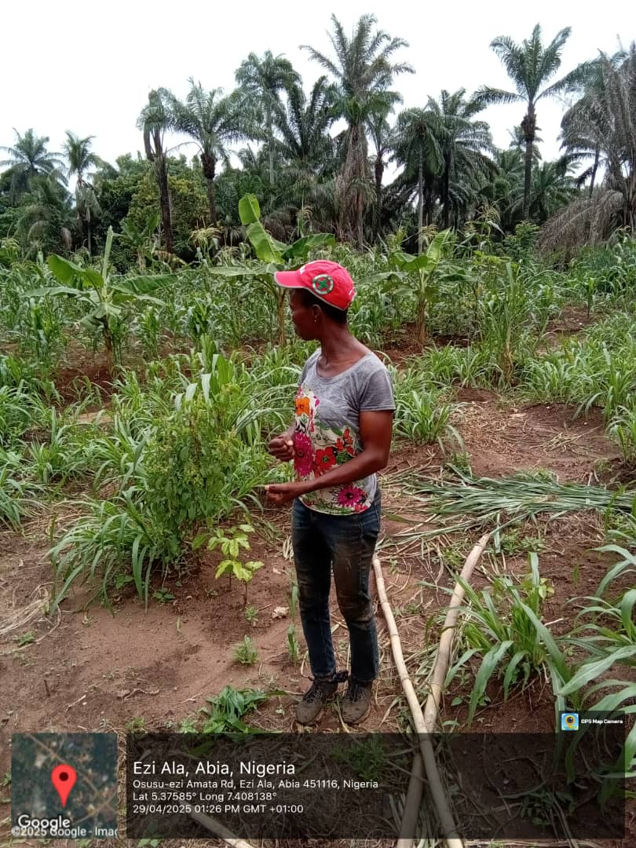
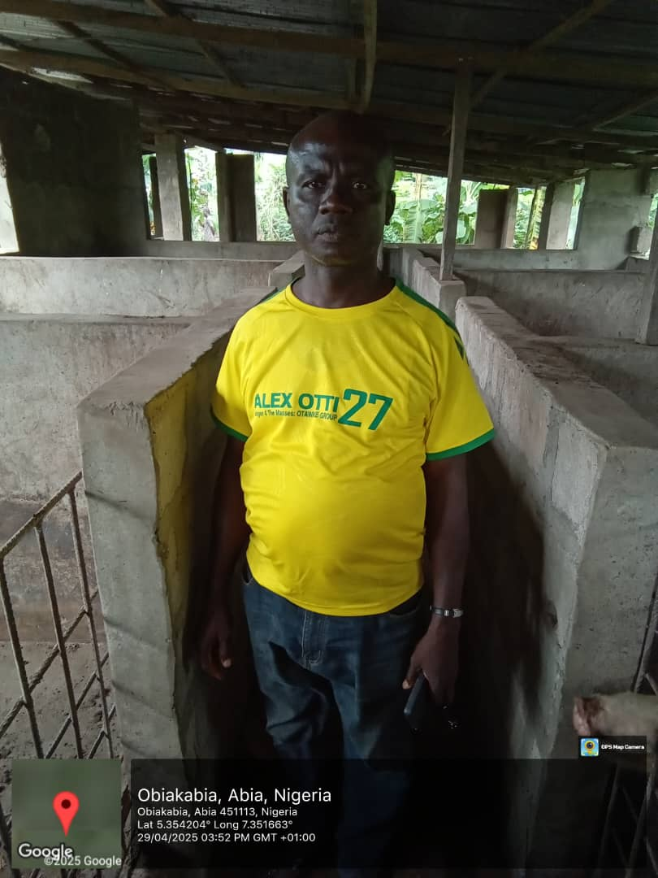
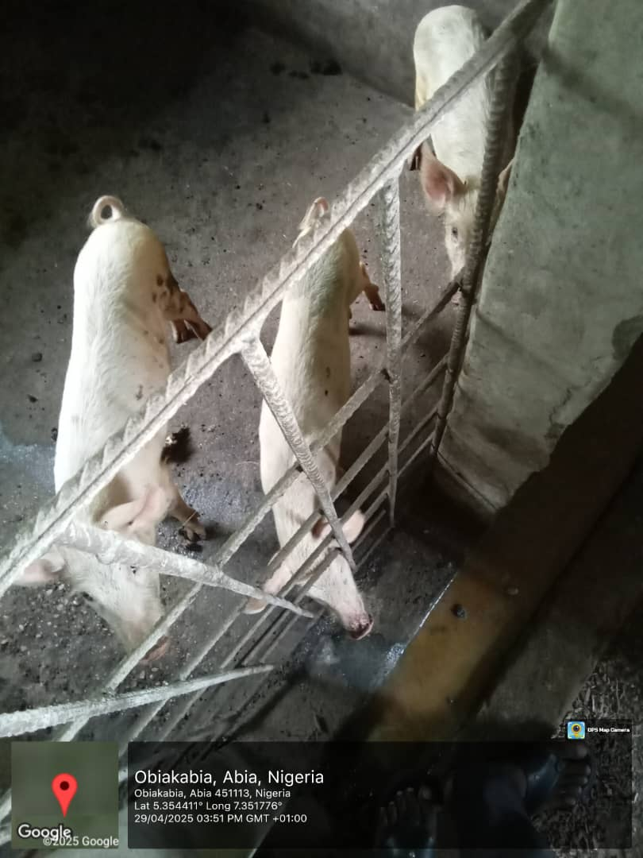
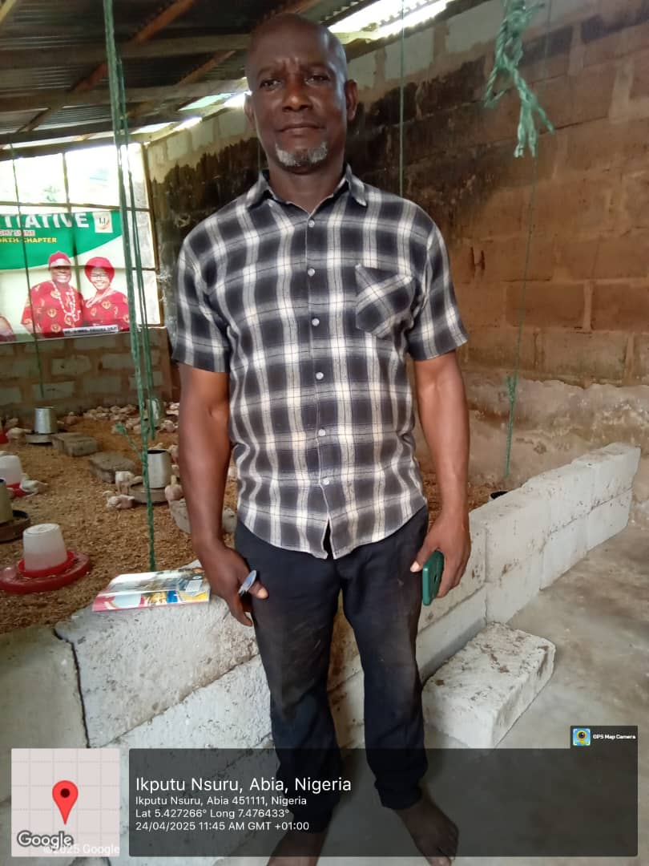
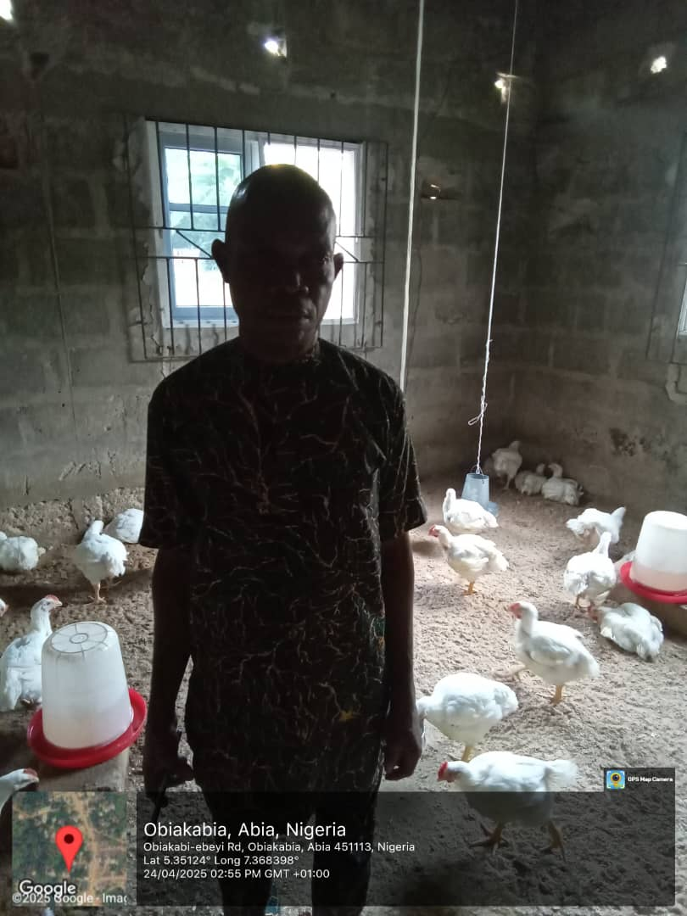
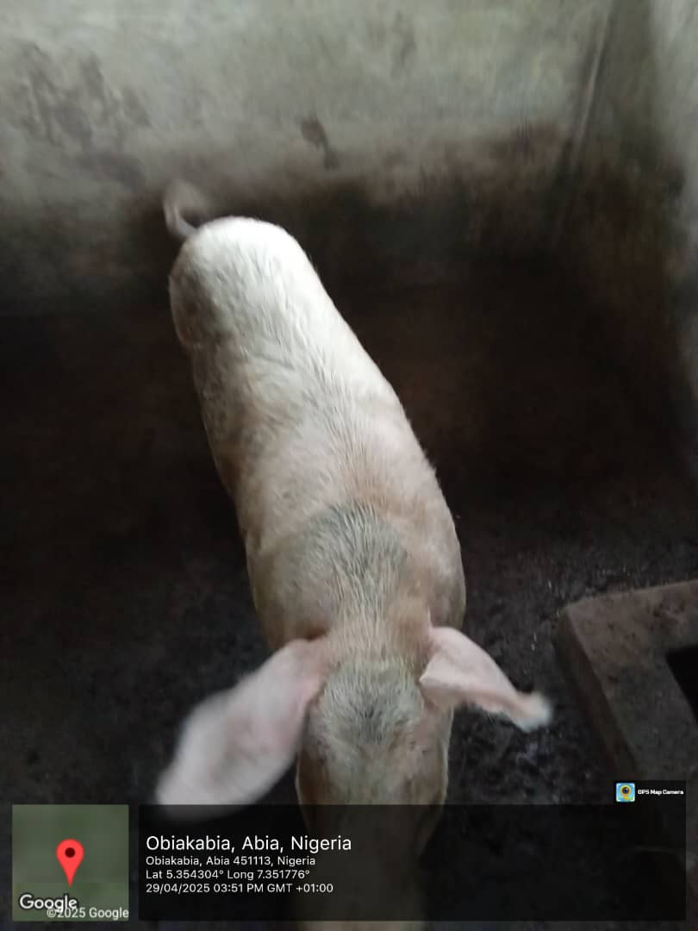
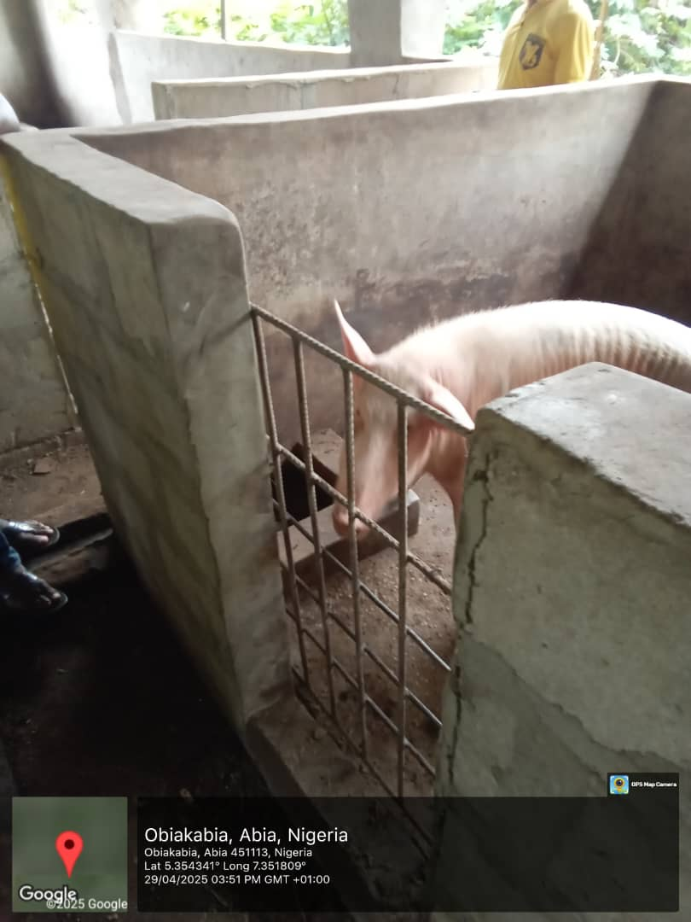
Isialangwa North
This beneficiary is into integrated farming and also produces liquid eco-friendly fertilizer and insecticide using plant leaves
Another poultry farmer beneficiary with his healthy birds
A beneficiary in his poultry farm with few weeks old chicks
A pig farm owned by the beneficiary with a boar, sow and piglets

Slide 19
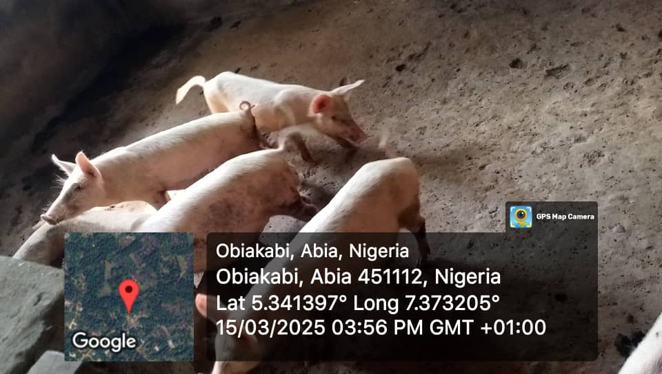
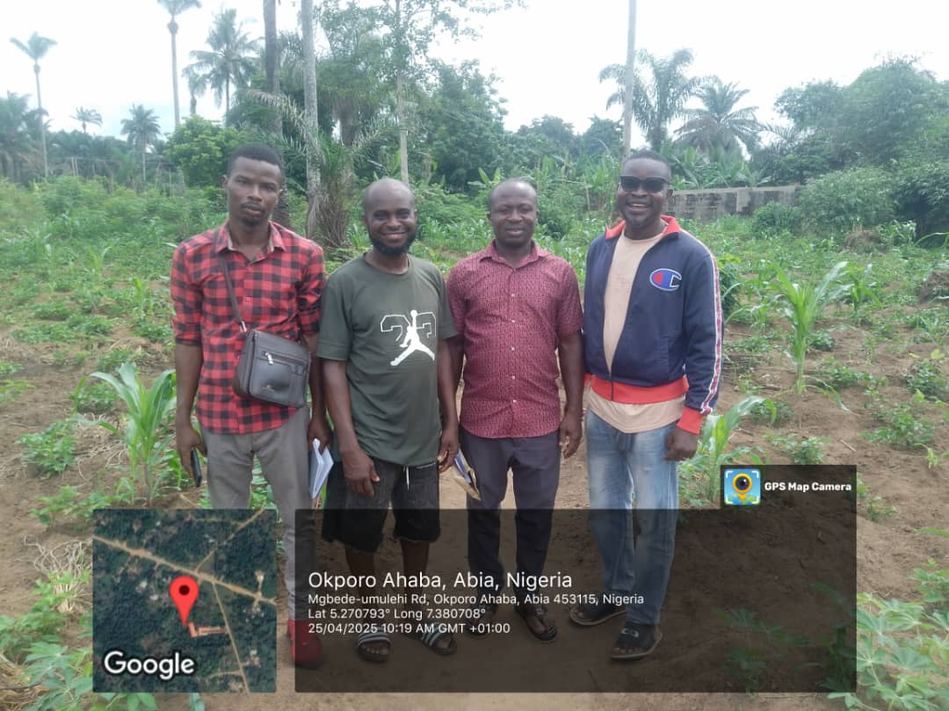
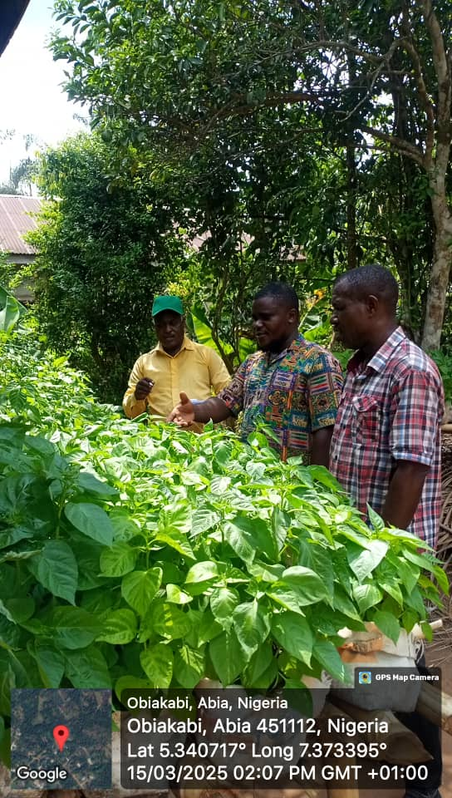
Isialangwa South
A pig farm owned by one of the beneficiary in Obiakabi
An open field beneficiary (in polo and black short) with the supervisory team.
A beneficiary showing his pepper nursery to the Director and his team

Slide 20
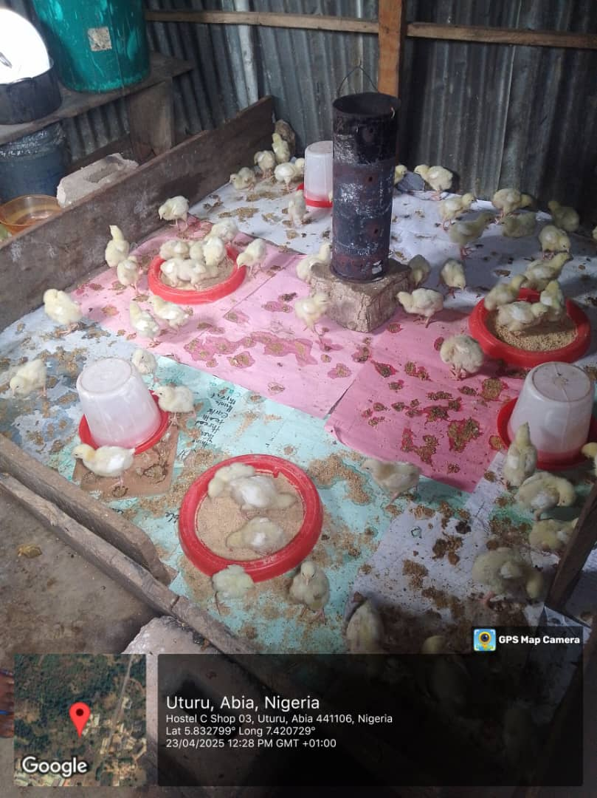
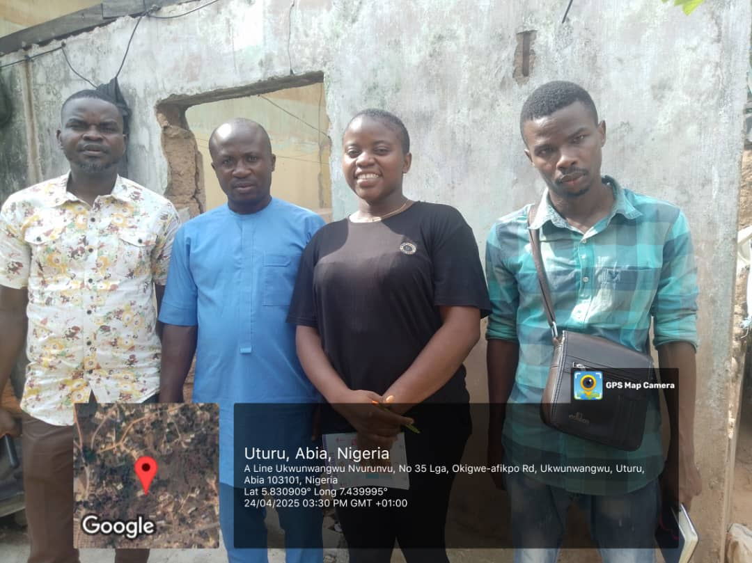
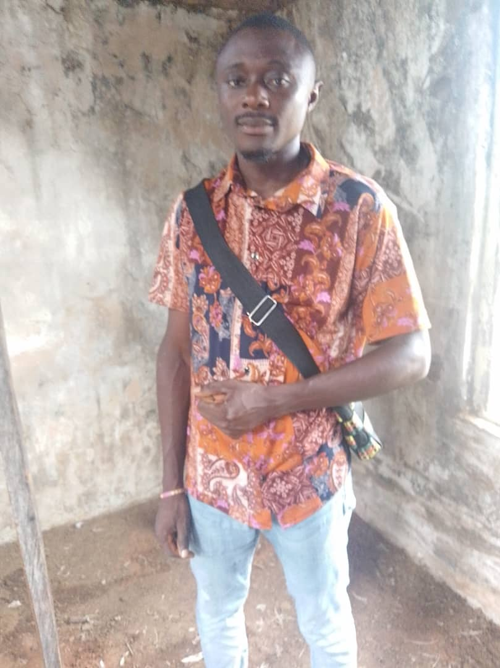
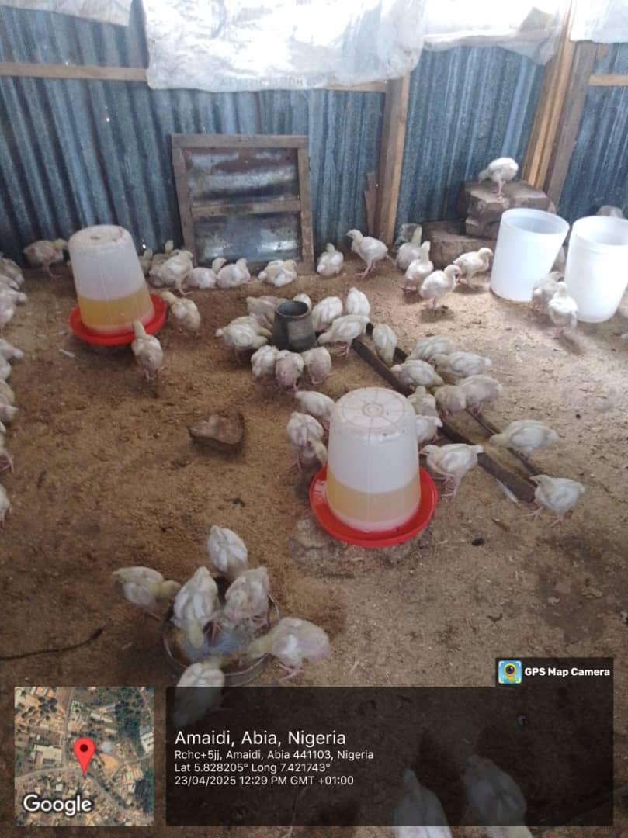
Isuikwuato
A beneficiary (female) with the supervisory team and her few days old chicks under brooding
Another poultry farmer beneficiary with about 3 weeks old birds

Slide 21
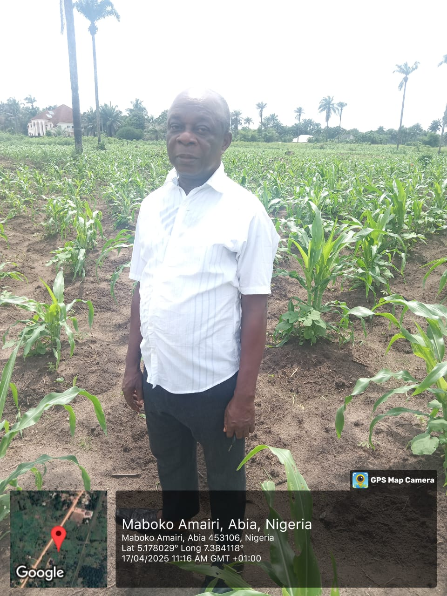
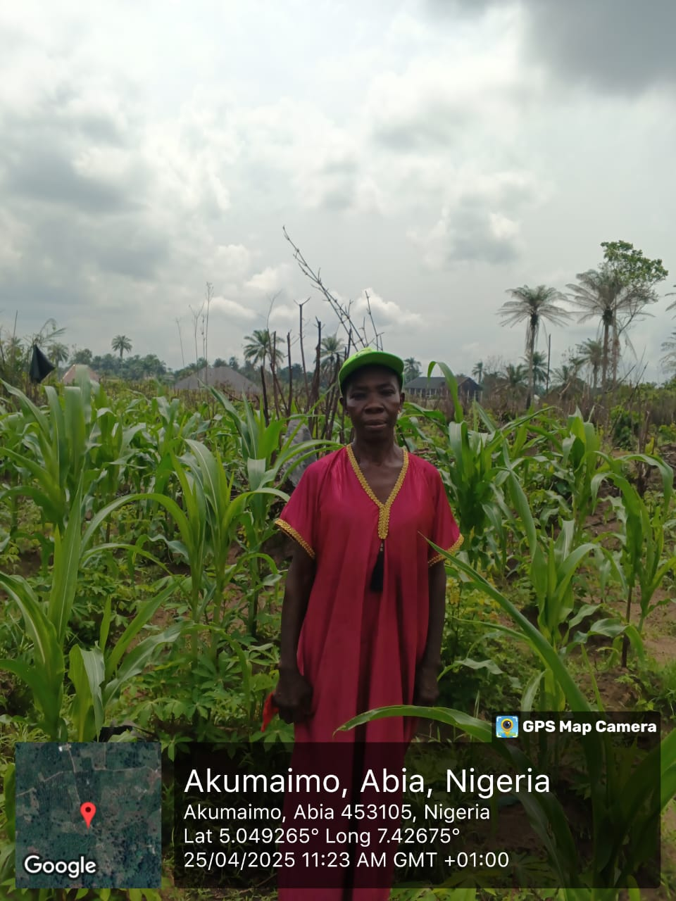
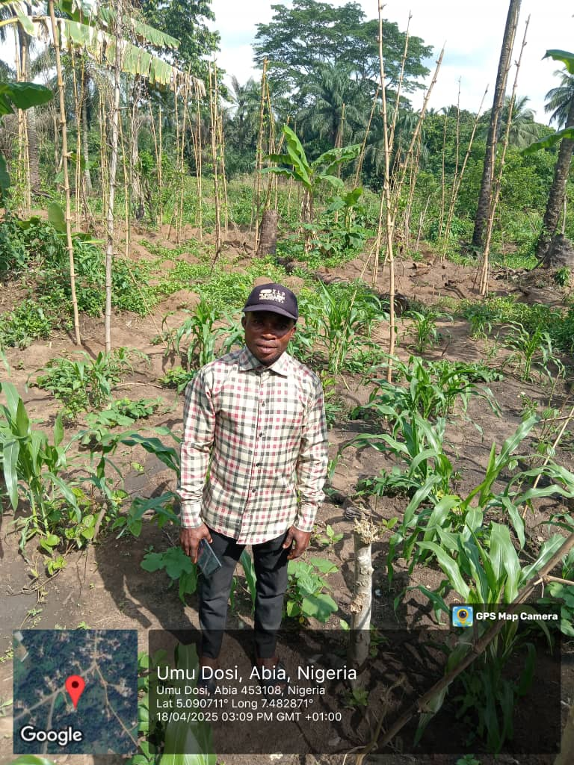
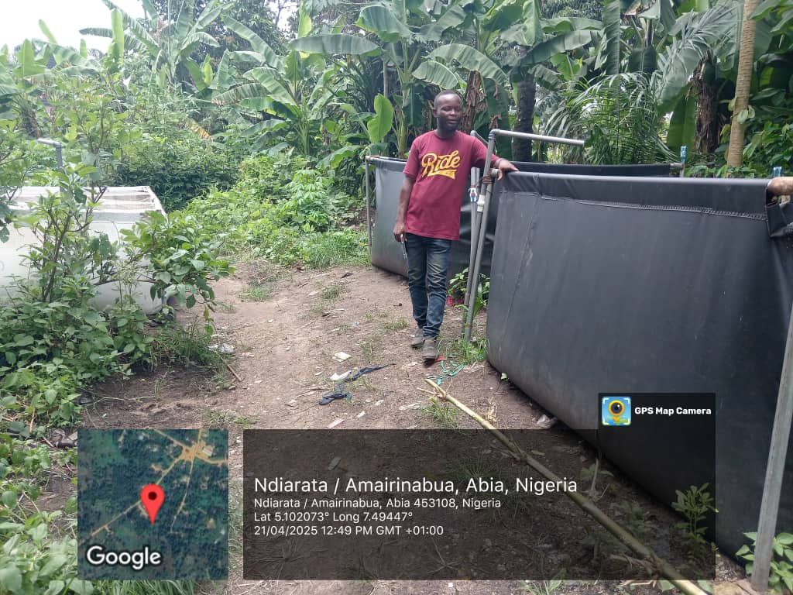
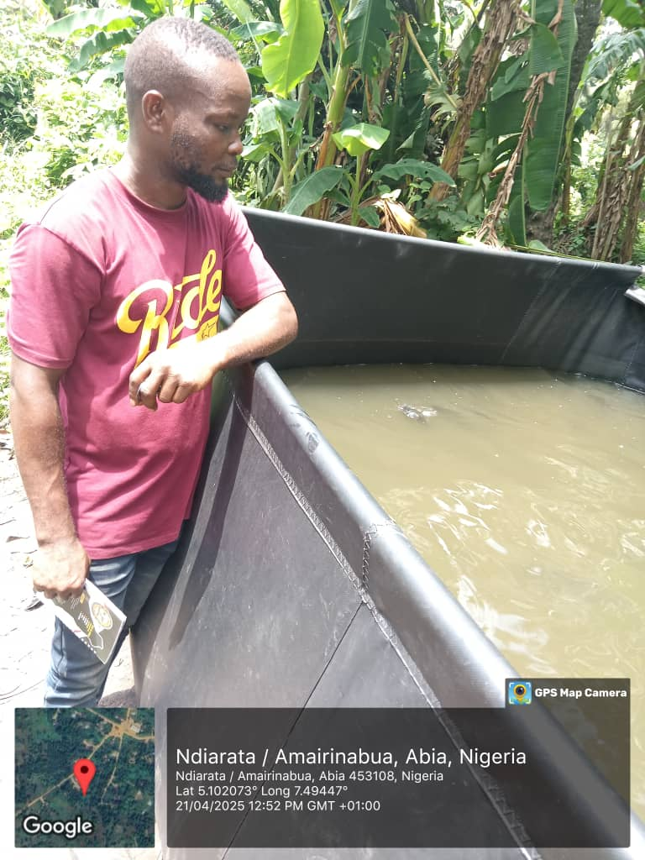
Obingwa
Open field beneficiaries in Maboko Amairi, Akumaimo and Umu Dosi showing their healthy crop farms
A beneficiary posing with his tarpaulin fish pond teeming with fish

Slide 22
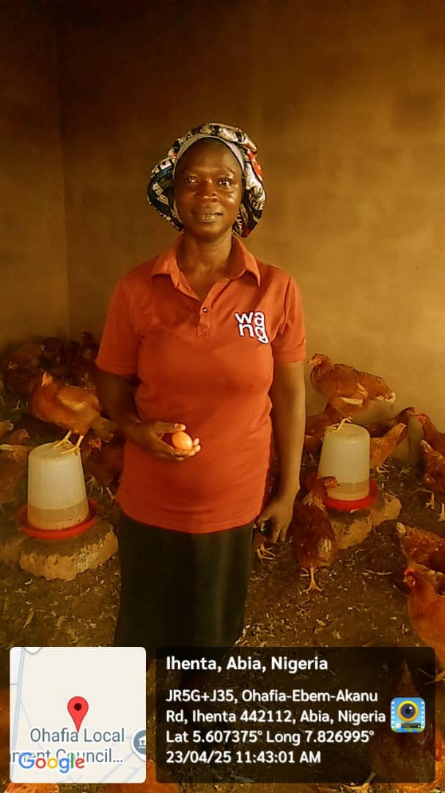
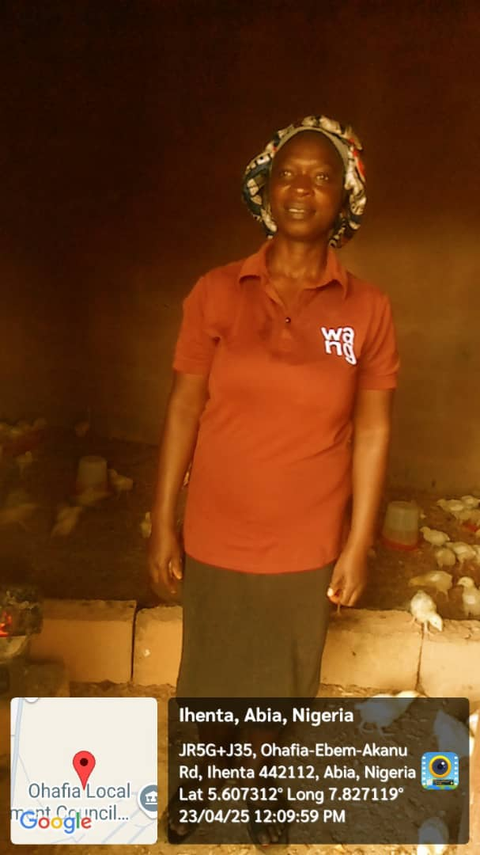
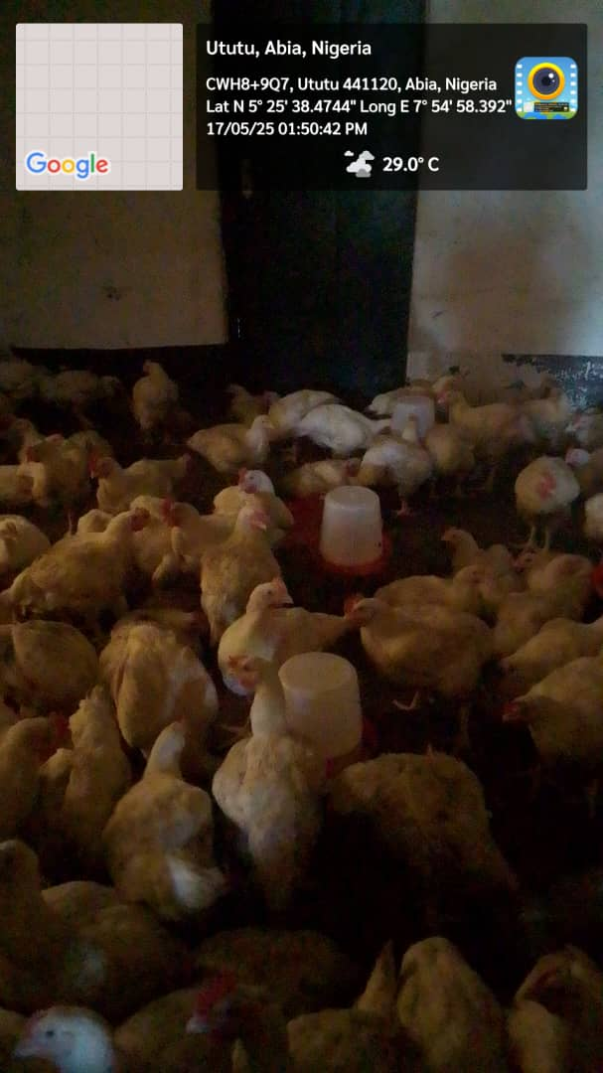
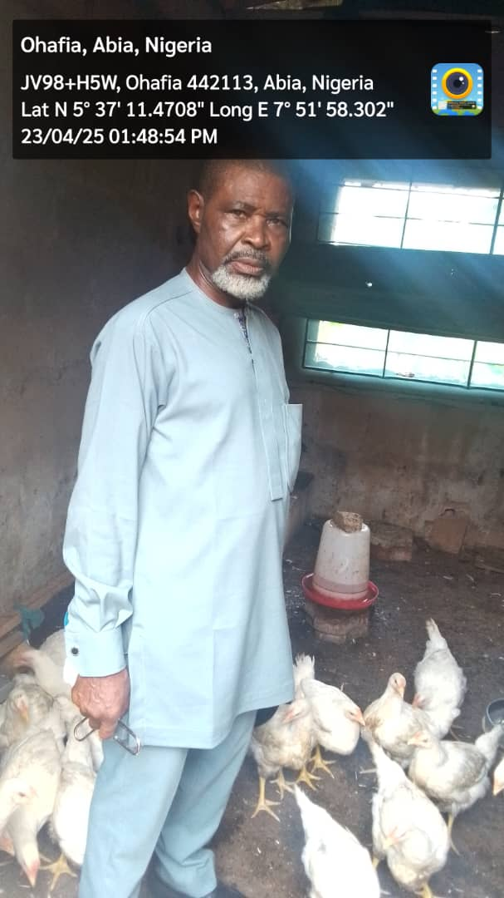
Ohafia
A beneficiary posing in her broilers and layers farm in Ihenta
A broiler farm owned by one of the beneficiary in Ututu, ready for market
A beneficiary in his broiler farm in Ohafia

Slide 23
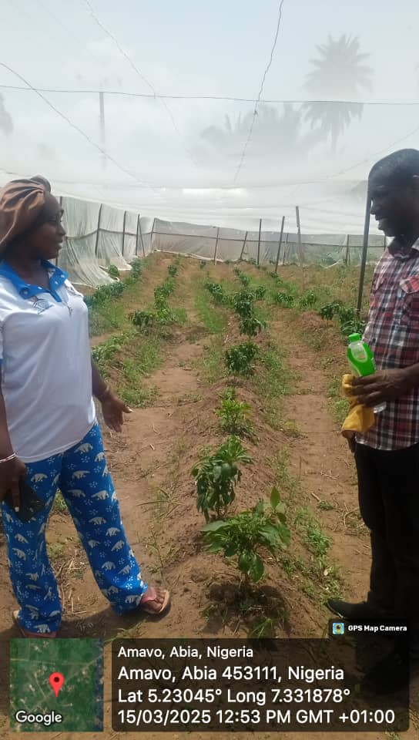


Osisioma
The Director and his team with a beneficiary in his pepper and ugu farm in Oso-okwa.
One of the few beneficiaries in green house been assessed by the Director.
A beneficiary in her cassava farm in Umuakpara

Slide 24




Ugwunagbo
From left to right: a poultry farm in Asa-Umunka with matured birds, open field beneficiaries in their maize/cassava farms in Asa Amanhie, Asa Umunka and Umu Aja, respectively.

Slide 25





Ukwa East
Open field beneficiaries been assessed by the supervisory team in Obohia and Ikwueke, respectively.
A rice field owned by a beneficiary, Christian Nweke and Sons
A pond filled with fish in Ohuru

Slide 26




Ukwa West
A beneficiary with his birds in Uzuaku
Another beneficiary in his poultry farm
A beneficiary (middle) with the supervisory team in her pepper farm

Slide 27






Umuahia North
A beneficiary showing her fish pond filled with fish to the supervisory team
A beneficiary posing in front of his poultry farm in Umuire
Another beneficiary in fishery enterprise
An open field beneficiary in his sweet potatoes' enterprise
A value addition beneficiary, processing unripe plantain into flour

Slide 28





Umuahia South
Poultry farm in Ubakala
Pig farmer with over 50 piglets in Umuahia
A beneficiary with a well constructed pond with robust and healthy fish in Amakama
Another pig farmer (in black shirt) with the supervisory team

Slide 29







Umunneochi
Another open field beneficiary (white top) with the team
An open field beneficiary with the supervisory team in his cassava/maize/yam farm
A beneficiary from Umunneochi showing his cassava processing enterprise located in Umudike, Umuahia
A poultry farmer (layers) beneficiary (Green top)

Slide 30





THE FOLLOWING BENEFICIARIES AS AT THE TIME OF VISIT, WERE YET TO START UP THEIR ENTERPRISE
S/N | Name of Beneficiaries | Phone No | LGA | Enterprise | Address
1 | Njoku Stanley Ogburubi | 08039519252 | Aba North | Poultry | Ogbor/Ogbor II Ward 11
2 | Precious Ugoeze Agua | 08065219840 | Osisioma | Poultry | Umumgbede
3 | Ehumadu Bertha Eziuche | 08036134625 | Osisioma | Value Addition (Poultry feed production) | Umuocham/Osisioma ward 3
4 | Ejike Tochukwu U. | 08067074725 | Ugwunagbo | Poultry | Amaoji/ Uzougwu 5
5 | Chimuanya Marvis Okwudiri | 08036330932 | Ukwa East | Poultry | Ohanku/ Ikwuori 3
30

Slide 31





THE FOLLOWING BENEFICIARIES REFUSED TO PRESENT THEMSELVES FOR SUPERVISION
S/N | Names of Beneficiaries | LGA | Phone No. | Contact address | Sponsors
1 | Okoko Amaranna Patrick | Arochukwu | 09066427974 | Ozu Abam/78 St. Michael Road Aba
2 | Kalu Sunday | Arochukwu | 08059661080/ 07084735888 | Obimba Auth. Community, Iheosu-Isu/ Igwebuike Ward 7
3 | Okoroafor Godswill Nwabueze | Arochukwu | 07033177095/08037071600 | 5 Frank Ibe Drive, Isialama Afaraukwu, Umuahia
4 | Okoro Chukwu- ebuka Miracle | Arochukwu | 081384475509/07038656321 | B4^{A} Ehimiri Hosing Estate, Umuahia
5 | Osondu Nnamdi | Ikwuano | 08066521467 | Nchara Oloko
31

Slide 32





THE FOLLOWING BENEFICIARIES REFUSED TO PRESENT THEMSELVES FOR SUPERVISION
S/N | Names of Beneficiaries | LGA | Phone No. | Contact address | Sponsors
6 | Chiedozie Godswill Egbe | Ikwuano | 07025071210 | Egbe’s Compound Ogbuebule, Oboro
7 | Awuwa Lucky Chibuikem | Ikwuano | 08032537607/08051381058 | Umuagu Ibeku Umuahia North
8 | Ezegbe Chinyere Peter | Ikwuano | 07037125986 | 21 Igbo Street, Umuahia
9 | Kingsley Ikechukwu Okoebue | Isialangwa North | 08038503664 | Eziama Nsulu/ Ward 3
10 | Ifeanyi Ransom Okereke | Isuikwuato | 07032387381/09068965190 | Umuchioke, Akpukpa Uturu/ Ward 8
32

Slide 33





THE FOLLOWING BENEFICIARIES REFUSED TO PRESENT THEMSELVES FOR SUPERVISION
S/N | Names of Beneficiaries | LGA | Phone No. | Contact address | Sponsors
11 | Nwachukwu Uzochim P. | Obingwa | 08103525262 | 14 Zerock Street Aba, Abia State
12 | Ume Onu Enyinnaya | Ohafia | 07062204389 | 3 Oba Elu Road, Elu Ohafia
13 | Arunsi Ukoha Kalu | Ohafia | 08101218459 | 9 Ota Okoro Lane, Okagwe, Ohafia
14 | Chike Peter Igwe | Ohafia | 07032118263 | No 85 Arochukwu Road Amaekpu Ohafia
15 | Azubuike Kelechi | Osisioma | 08057437045/07010923238 | Ozigara Azubuike’s Compound, Okpu-Umuobo village
33

Slide 34





THE FOLLOWING BENEFICIARIES REFUSED TO PRESENT THEMSELVES FOR SUPERVISION
S/N | Names of Beneficiaries | LGA | Phone No. | Contact address | Sponsors
16 | Chioma Orji | Osisioma | 08024048247/ 08088111110 | Umuekpe Village
17 | Ogbuka L. Ugonwanyi | Ugwunagbo | 08067243440/ 08113377775 | 9 Umuode Road, WBH Abayi, Aba/ Amorji Ihie-Iyi, Ugwunagbo
18 | Nwankpa Martins | Ugwunagbo (His farm is located in Taraba state. | 08134411209 | 96B Aba-Owerri Road, Aba
19 | Chikamnele Hossanna C. | Ugwunagbo | 08086443711 | 56 Umuagbai Road, Aba/ Amuzi Ihie
20 | Uko ThankGod Chukwuemeka | Umuahia North | 09066954725/ 08167295293 | Nkweogwu, Umuahia
34

Slide 35






THE FOLLOWING BENEFICIARIES REFUSED TO PRESENT THEMSELVES FOR SUPERVISION
S/N | Names of Beneficiaries | LGA | Phone No. | Contact address | Sponsors
21 | Chukwunonso Udonsi | Umuahia North | 09011348236 | Road 040 WBHE Umuahia
22 | Austin Ikeji | Umuahia North | 07032799079 | Umuagbom Umukabia, Ohuhu
23 | Egwu Chinwenwa Jessica | Umuahia South | 09054734618/ 09071998596 | 100 Carmoon Street by Enugu Road/ Agbama Olokoro
24 | Jeremiah Dearest | Ukwa East | 08134413482/ 09044282015 | Obuozu Ndoki, Ukwa East
25 | Nwogu Raphel | Ukwa East | 08034858201 | Umuokoroaja Obohia-Ndoki, Ukwa East
26 | Nwankwo Emeka K. | Ukwa West | 09068749709 | Umuram, Ogwe Ukwa West
35

Slide 36

Prayers
Roll over all the loans for the 259 performing (scores 2 to 5) beneficiaries for one full year
Reward those in the upper 3 performance categories as follows:
First category (60) – Enhance loan amount by 50%, implication = N53.6m
Second category (111) – 30% enhancement to loan amount; implication = N65m
Third category (77) – 20 % additional loan; implication = N29m
Poor performance: carry out in-depth situation analysis to determine if/type of further intervention needed.
Sanction the deviants as follows:
Zero performance – demand full recovery of loan amount
Those that failed to present for assessment – revisit and assess
Those that refused to be assessed:
Pursue recovery,
Invoke the GSI (global standing instruction) clause in the loan agreement;
Enforce through their sponsors
Blacklist against future state benefits
Extend N1m flat empowerment interest-free loan to all the certified incubatees
Extend program to other Abians collaborating with MOUAU ABIC. Ok but revisit and evaluate infrastructure.
Working with the PPP/IPO, collaborate with CSS Farms or any other similarly credible Company/co-investor (possibly from the prospective investors pool) to set up similar large scale integrated farm in Abia state with significant government funding.
Abia State CSS Farms Project Initiative
36

Slide 37
Thank You

